Slide 1
PROVIDING DATA PRIVACY OF E- HEATHCARE DATA
BTech in Information Technology
PRESENTED BY
SUBHAJIT GHOSH Roll: 10000220058 Reg.:201000100220058
JOTIRMAY SIKDAR Roll:10000220060 Reg.:201000100220007
RAJIB KUMAR MAJUMDER Roll: 10000219024 Reg.: 030957
SAPTARSHI MONDAL Roll: 10000219074 Reg.: 043001
Guided By:
SAYANTANI SAHA
Department of Information Technology.
Maulana Abul Kalam Azad University Technology, West Bengal, India

Slide 2
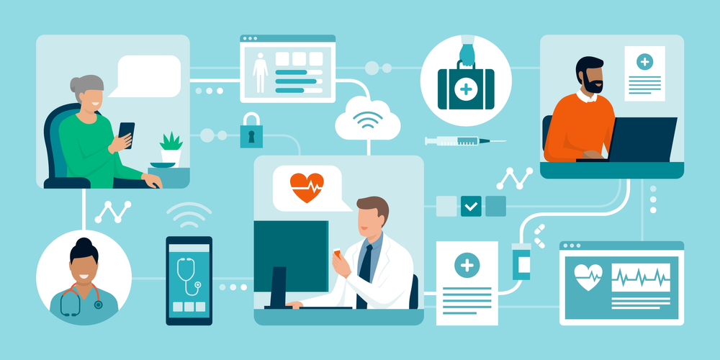
Motivation
Health data is so sensitive data. Only legitimate users should get access to it. No other medical personnel should access the data without permission. So, data need to be protected with a proper cryptosystem. Now the traditional cryptosystem is not able to provide end-to-end security to the system. Encrypting each patient’s data with an encryption key and sharing the key with the user -- is a very common method to maintain security. However, this traditional approach is not very efficient. First, it is going to store a huge number of encryption, and decryption keys, and key sharing should be done in the proper way to secure the system. In case the user like a doctor or nurse or any other user is changed we need to re-encrypt the patient data with a new key. so we need to separate the patient data into smaller chunk and share it with the concerned user. So here is the need to keep the data in an efficient data model system.

Slide 3
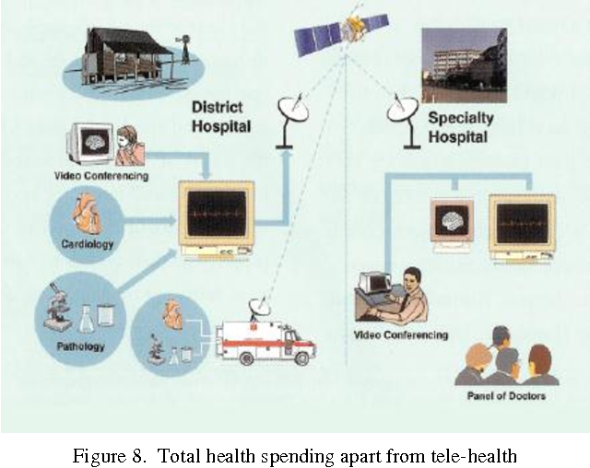
Literature Review
An Electronic Health Record (EHR) is a virtual platform that provides medical reports access to the EHRs and has the flexibility to supply information about patient care. Not only that the EHR demonstrated here to store and supply information for patients, but it also has an understanding of how data of the patient must be sent to users or staff of the HealthCare Center. This tool will also allow the patient to access their health data and give them better control over their health. The security part is an extensive part of this project, the security will be applied to the data which will be or are being sent to the different users or staff of the healthcare center. Currently, we are researching through the security of what type of security will be most appropriate and how to apply the security, and this is also the main challenge we are facing right now. The authors in paper [1] discussed the security challenges in the healthcare system.

Slide 4
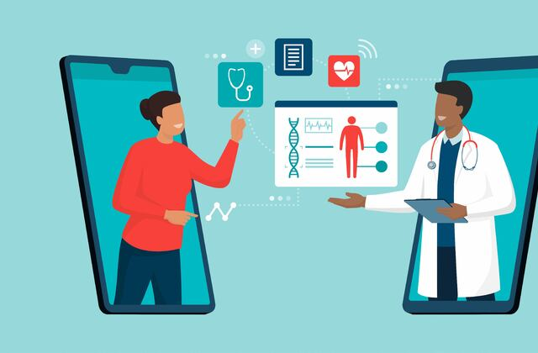
PROPOSED METHOD:
To collect most of the information about hospitality and medical services.
• Patients are easily allocated to the doctors.
• Doctors search and others medical stuff search is possible.

Slide 5
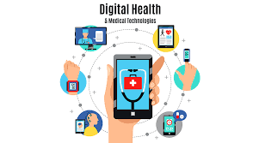
IN FUTURE
In future we will be using cryptography technical skills for data privacy.As a example we say that if a paitent admit in a hospital for his dieases .There dr .and register admin have some question for him .and its recorded by authority . And its stotre a data base.and second one is the same paitent is admit another hospital for another disease .here the previous hospital does not share the information of the paitent with the second hospital.Here is information blockage and data corrupt.only the dr. ,admin and the paitent accees the data.the pharmachist will not access the data .he just access the prescription.only the paitent have the main acees to share the data with the another hospital. All the medical staff can see only their relevant medical data others’ data will be protected from them.
NOW:
we use HTML for web page
CSS for web design and bootstrap for overall design
MongoDB as database
Express and Node Js for Middleware backend development. React for portal Frontend design.
Bcrypt, Hashing etc

Slide 6
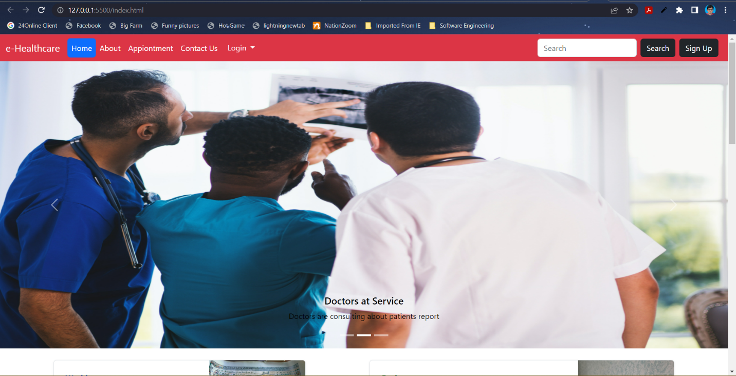
Front End

Slide 7
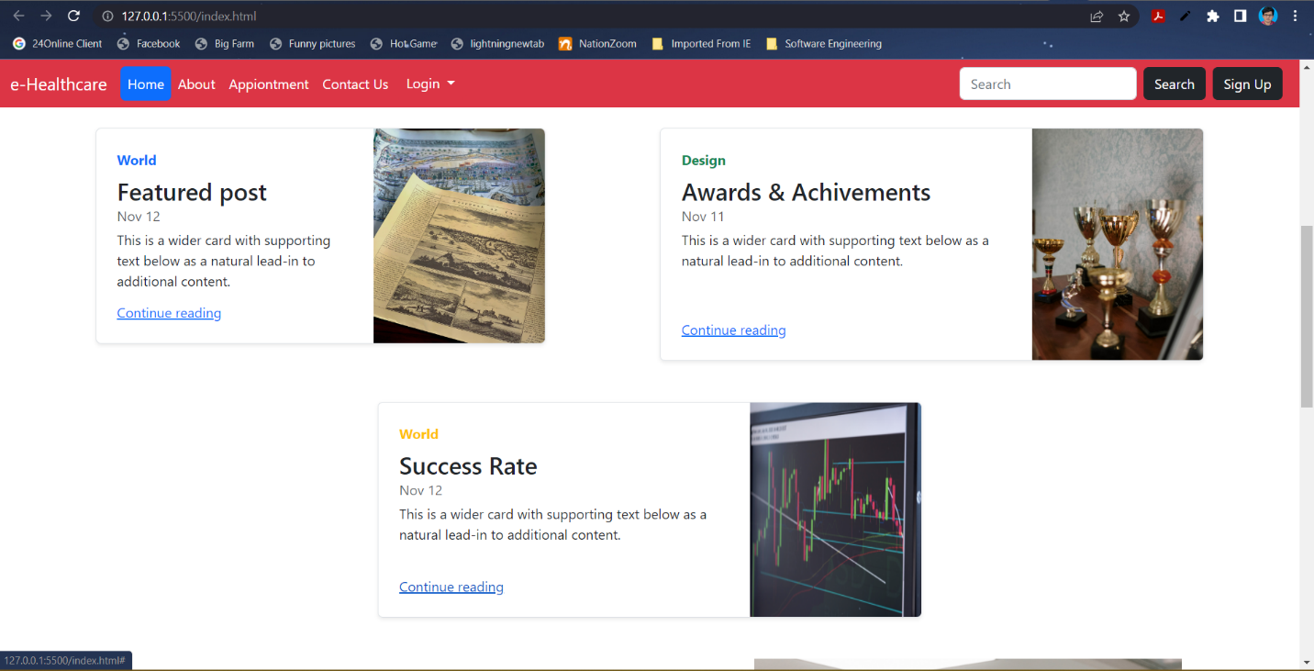

Slide 8
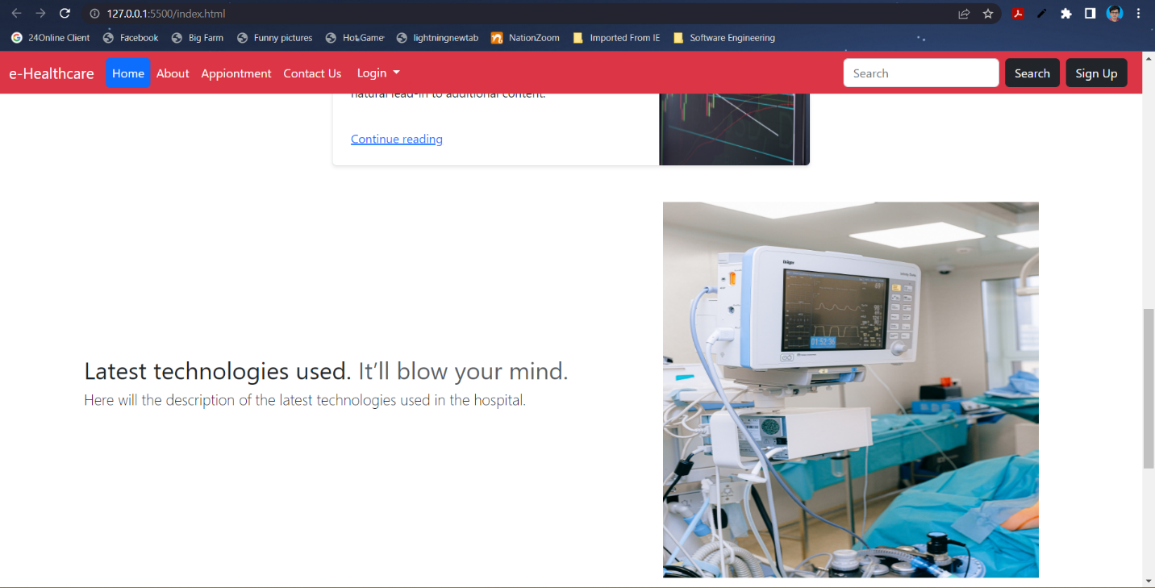

Slide 9
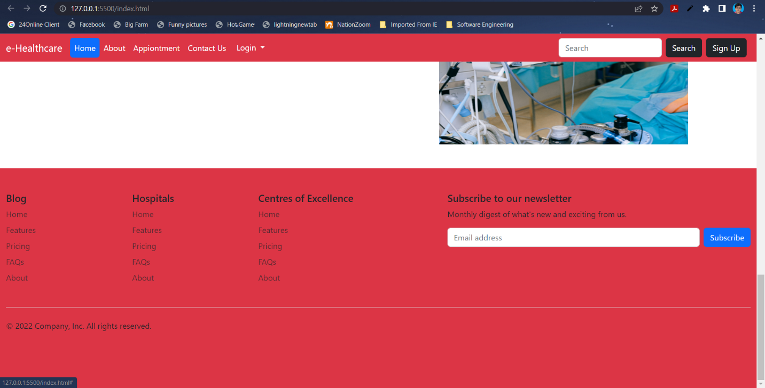

Slide 10
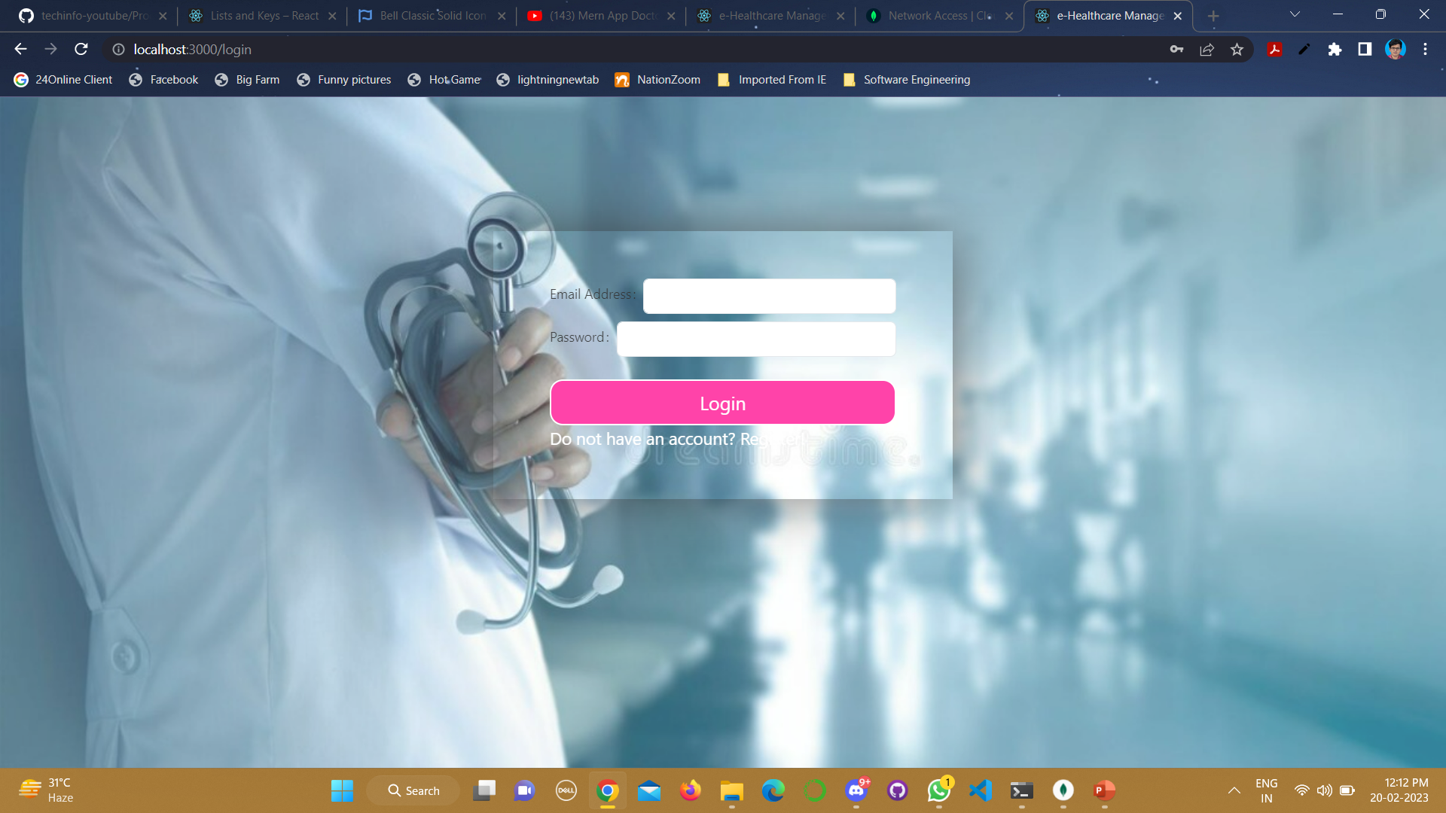

Slide 11
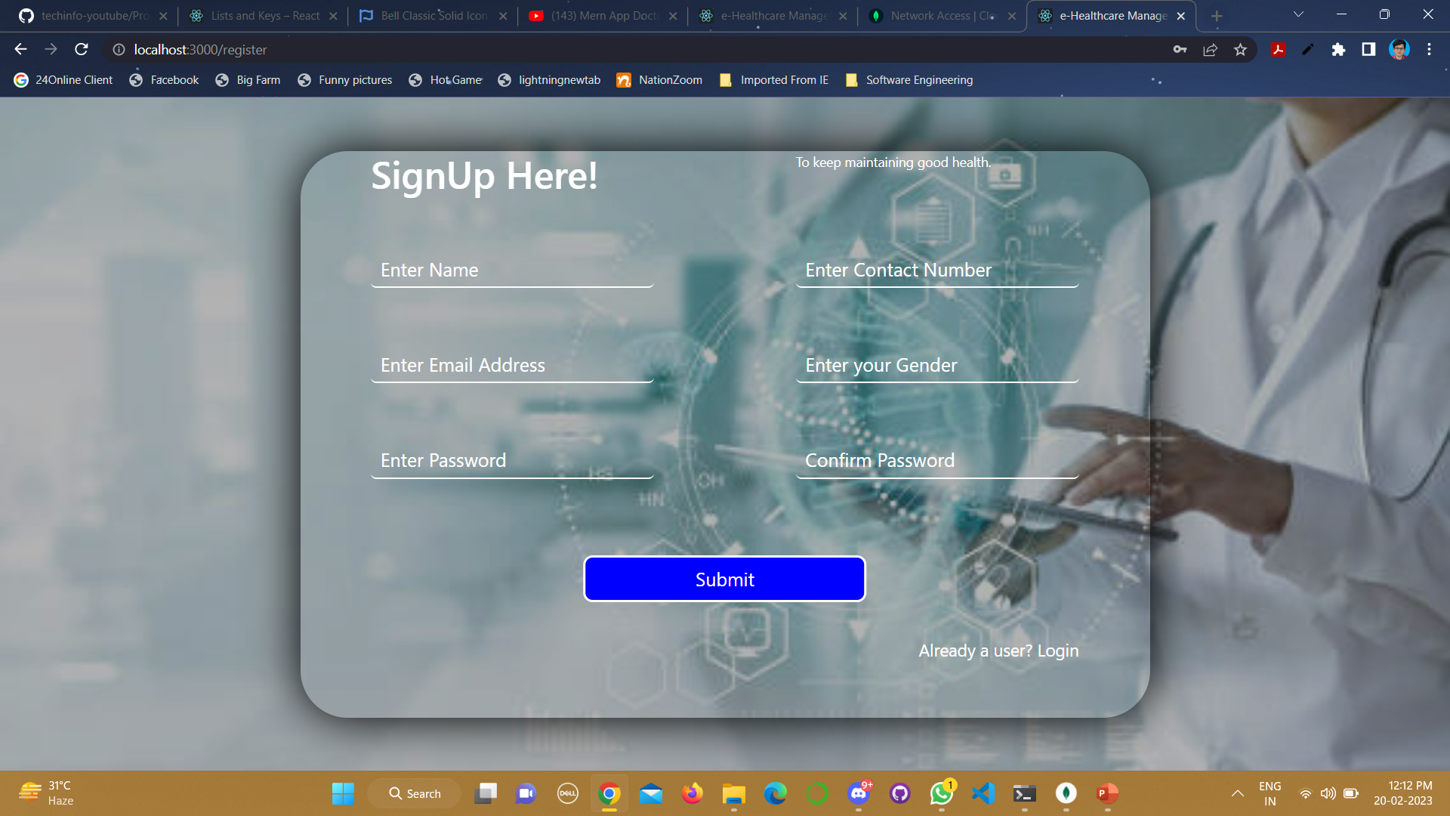

Slide 12
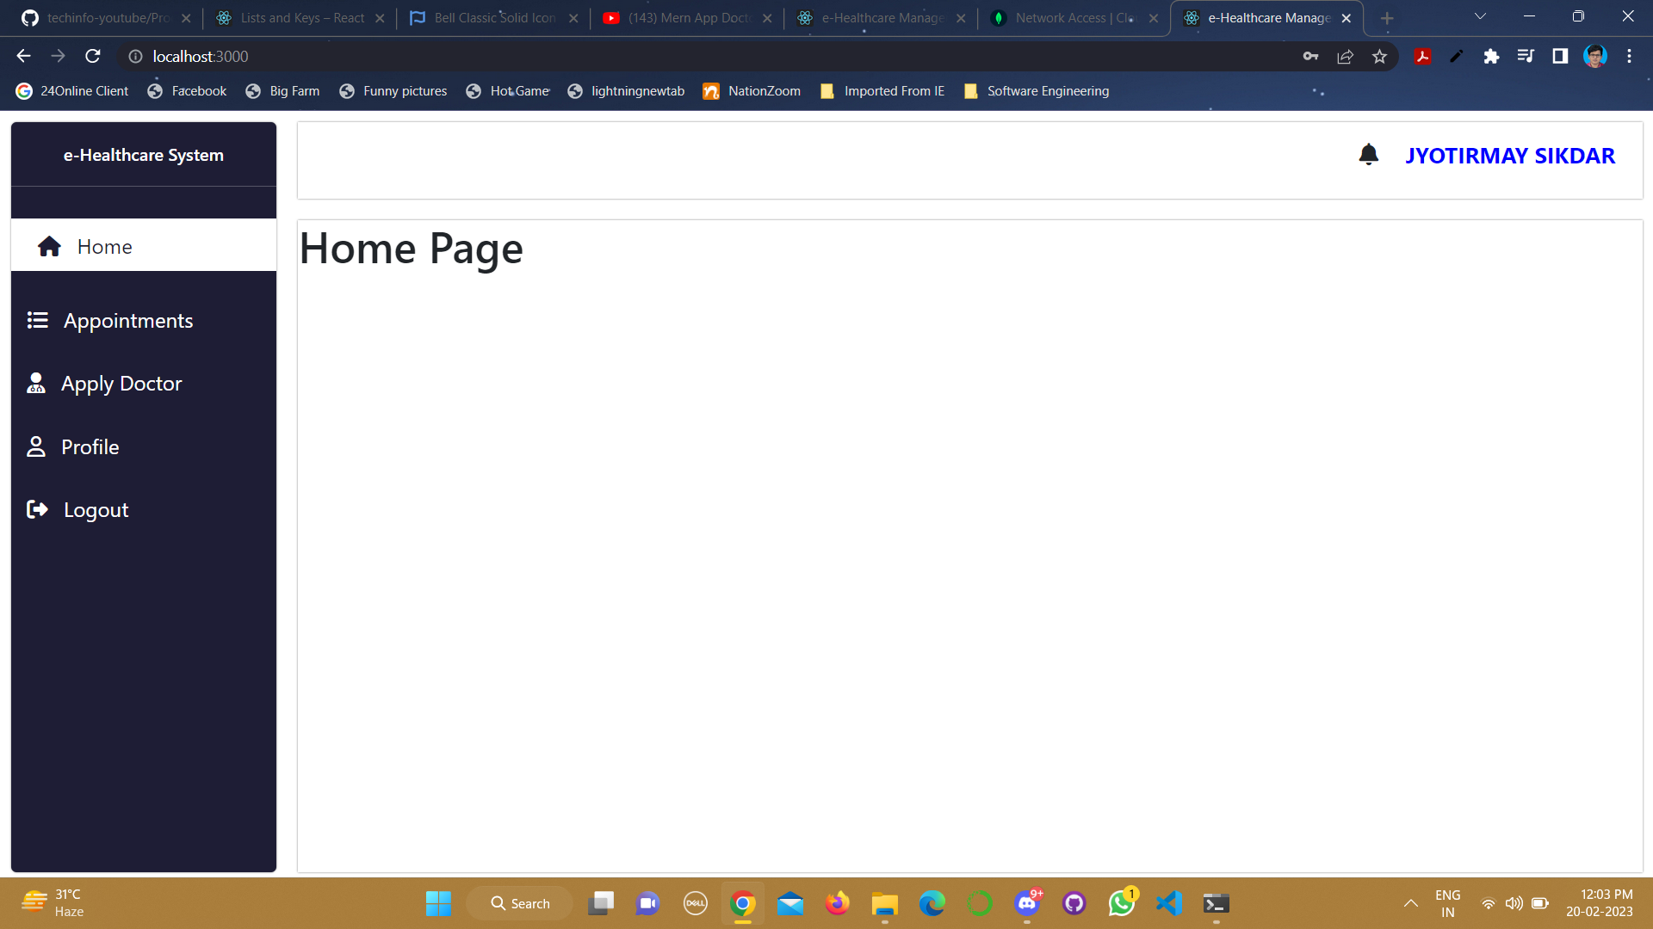

Slide 13
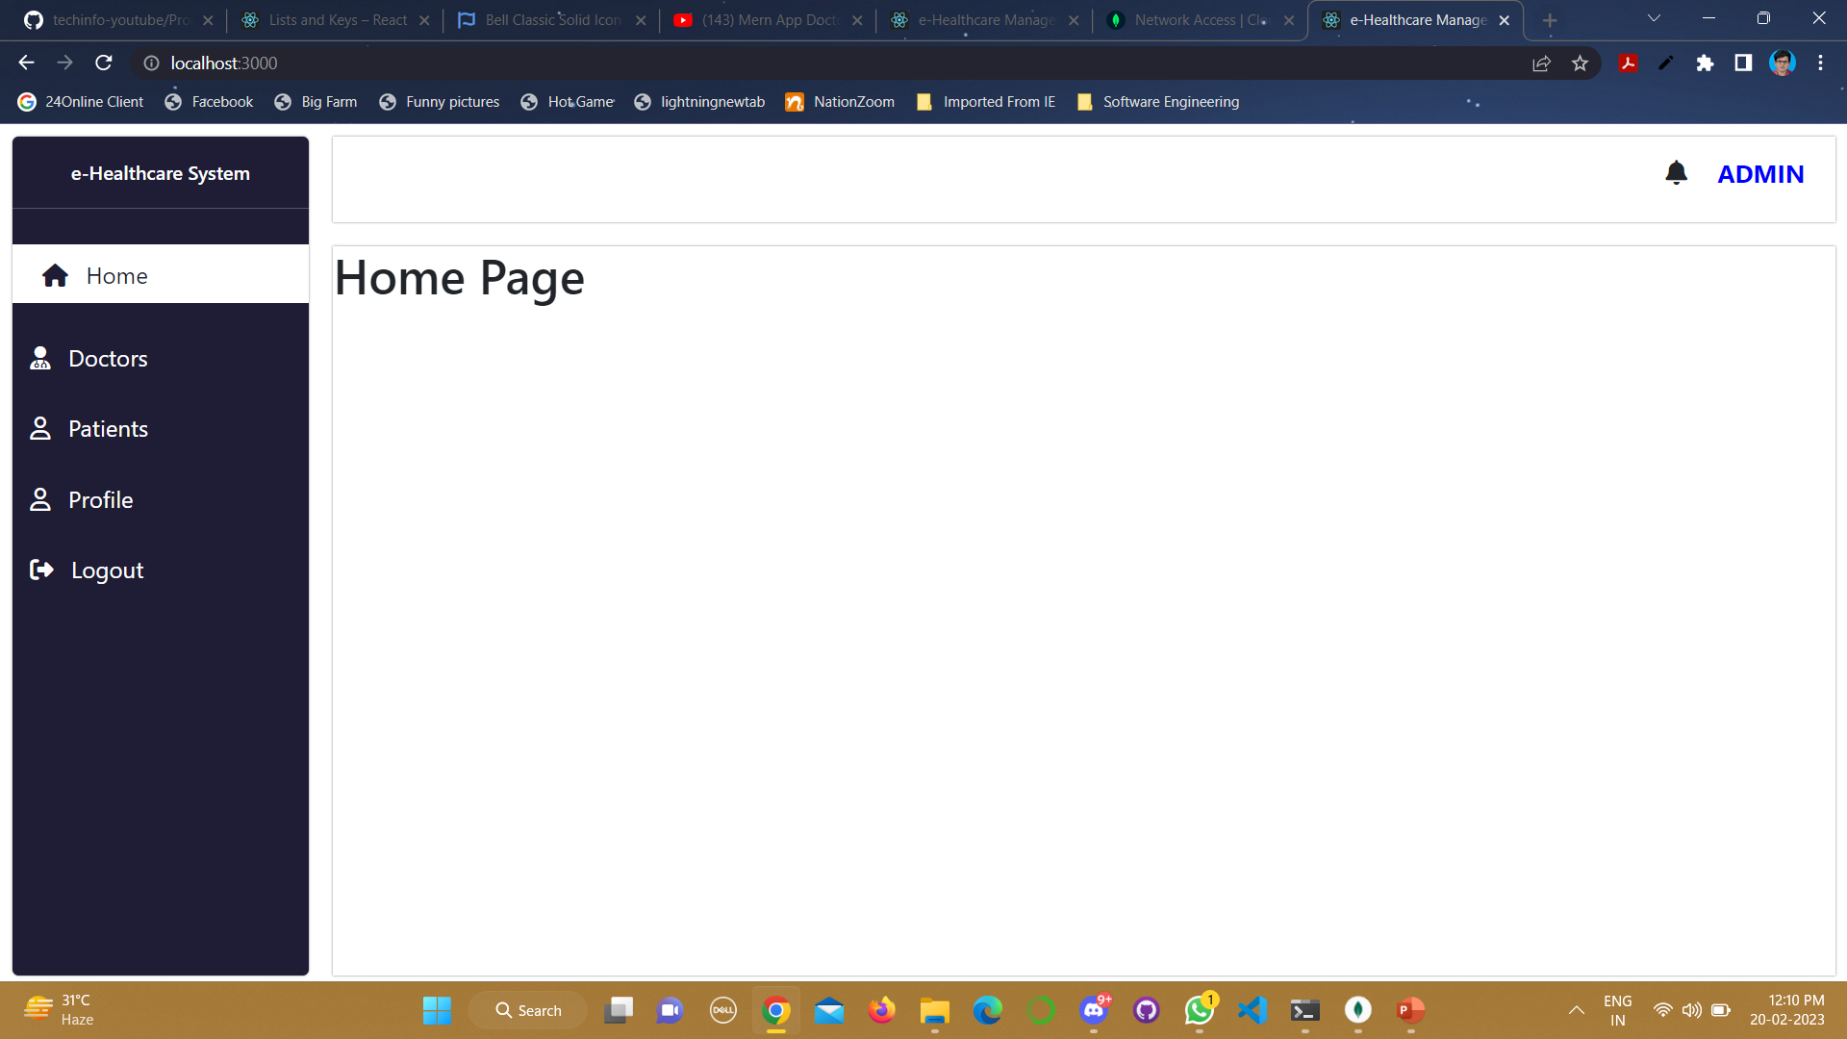

Slide 14
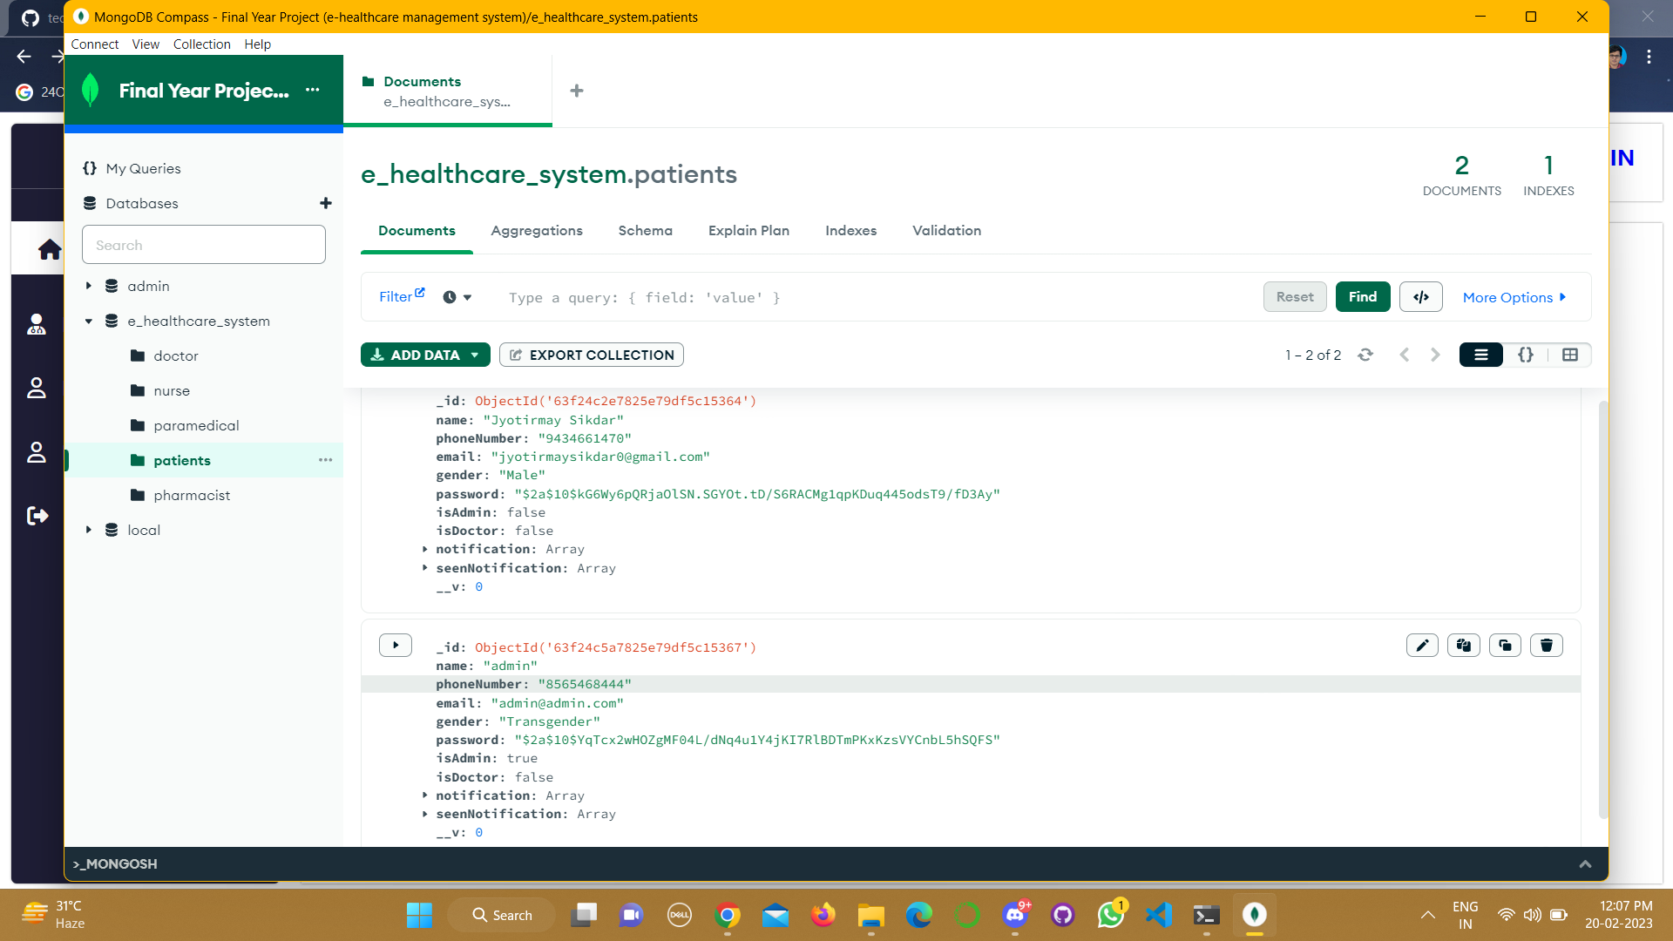

Slide 15
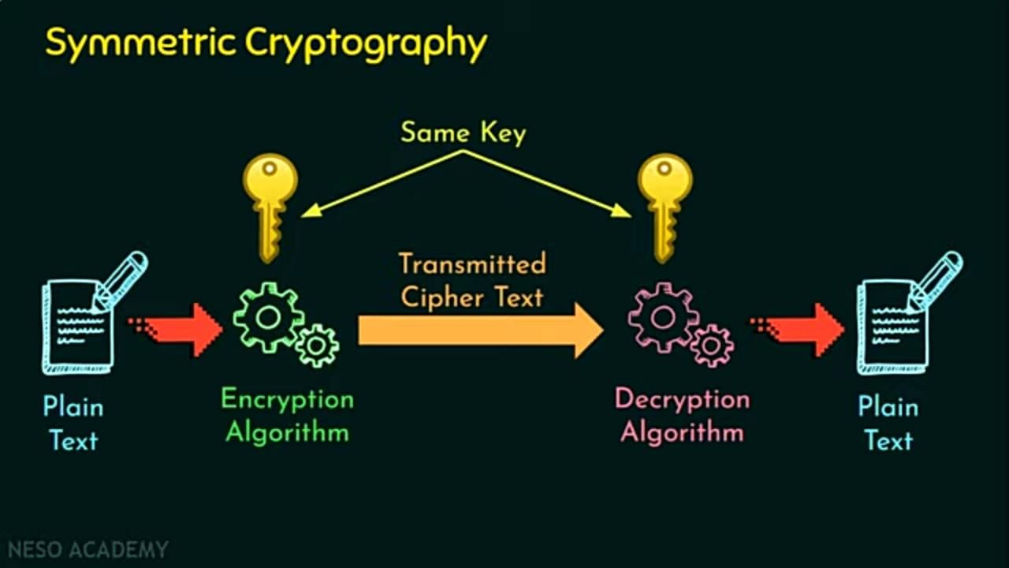

Slide 16
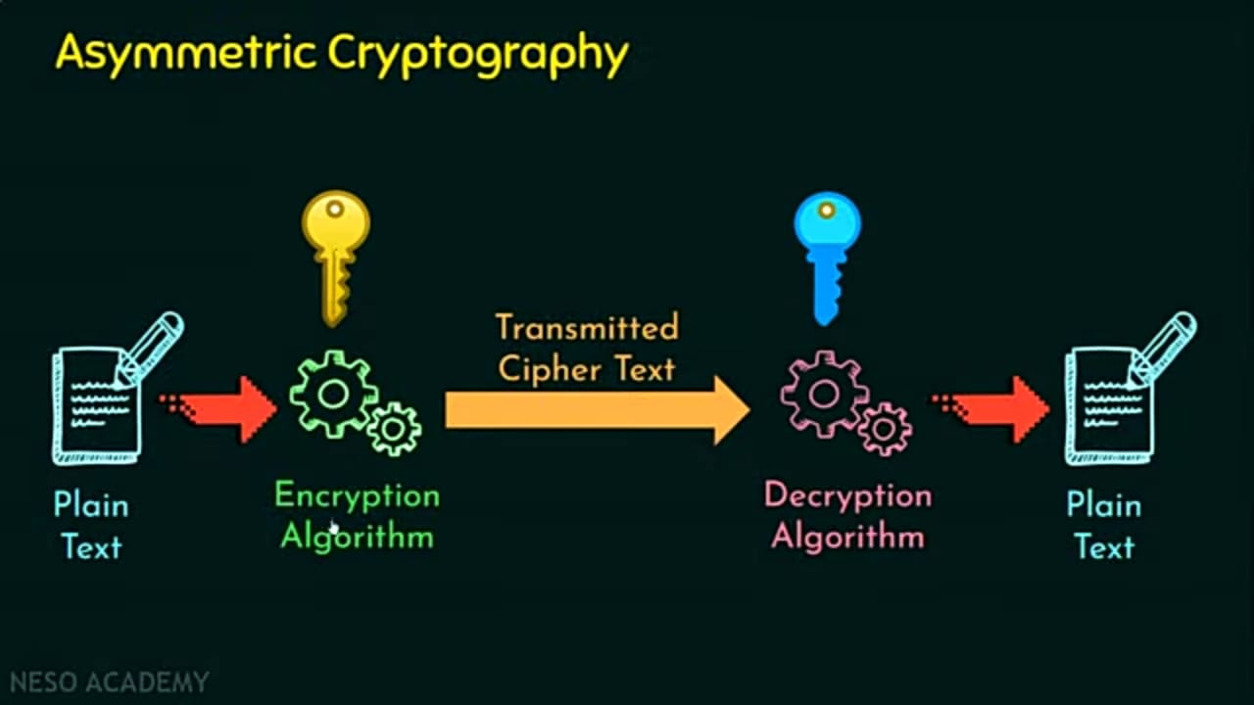

Slide 17
Conclusion
E-Health in the home is a potent, powerful and rich technology that offers significant benefits for many stakeholders.
We need to be sure, however, that when embracing this technology the elderly patient is not simply seen as another component in the "system“.
Individual patient needs and views regarding homecare and their health, safety, dignity, respect and fears must be listened to. With some limited exceptions, others cannot make assumptions in this personal and sensitive area.

Slide 18
Reference
[1] “Enhanced Data Security in Cloud-base E-Health Care System” by Asha Bhadra S Kumar, Aswanthy N, Elizabeth K Jacob, Arya Binu, and Ms. Divya S B.
[2] https://www.diva-portal.org/smash/get/diva2:647835/fulltext01.pdf.
[3] D. A. Garwin. (1993) Building a Learning Organization. Harvard Business Review. 73-91. Available: https://hbr.org/1993/07/building-a-learning-organization.
[5] J. M. McGinnis, L. Stuckhardt, R. Saunders, and M. Smith, the Best care at lower cost: the path to continuously learning health care in America. National Academies Press, 2013.
[6] J. Enticott, A. Johnson, and H. Teede, “Learning health systems using data to drive healthcare improvement and impact: a systematic review,” BMC health services research, vol. 21, no. 1, pp. 1-16, 2021. [Online]. Available: https://bmchealthservres.biomedcentral.com/articles/10.1186/s12913-021-06215-8#Tab3.
[7] T. Foley and F. Fairmichael. “Professor Charles Friedman Interview.” The Learning Healthcare Project. https://www.learninghealthcareproject.org/section/evidence/25/50/professor-charles-friedman-%20interview
[8] The University of Michigan. “Revolutionizing Learning, Transforming Health.” The University of Michigan. https://medicine.umich.edu/dept/learning-health-sciences
[9] MCBK. “Annual MCBK Public Meeting.” MCBK. https://mobilizecbk.med.umich.edu/news-events/annual-meetings
[10] MCBK. “Featured Events.” Mobilizing Computable Biomedical Knowledge (MCBK). https://mobilizecbk.med.umich.edu/news-events

Slide 19
THANK YOU

